Slide 1
NERVES

Slide 2
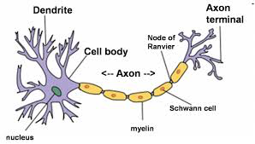
Neuron: Nerve Cell
Basic structural unit nervous system
Consists of:

Slide 3
Types of Neurons - Function
Sensory Neurons
carry messages to the brain and spinal cord (CNS) from body
i.e. pain, temperature……..

Slide 4
Types of Neurons - Function
Motor Neurons
carry messages from the brain and spinal cord (CNS) to body
i.e. typing a text message

Slide 5
Types of Neurons - Function
Interneuron/Connecting Neurons
Carry both sensory and motor messages
Found in CNS
Connect motor and sensory neurons

Slide 6
Example of neurons
Sensory neuron – seeing the ball coming towards your face
Interneuron –changes message and connects to motor neuron
Motor neuron – tells you catch the ball

Slide 7
Impulse Transmission Steps

Slide 8
Impulse Transmission Steps
1. Dendrites receive information

Slide 9
Impulse Transmission Steps
2. Myelin allows for fast impulses as it can jump from one node of Ranvier to the next

Slide 10
Impulse Transmission Steps
3. Goes from axon to axon terminal.

Slide 11
Impulse Transmission Steps
4.Chemicals called neurotransmitters released from axon terminal

Slide 12
Impulse Transmission Steps
5.The transmitters cross the synapse (space between the neurons)

Slide 14
Impulse Transmission Steps
6. They activate impulse on next neuron by attaching to dendrites

Slide 15
Notes:
Explain what is happening to partner

